Slide 1

Credit Card Fraud Detection
DS Classification project

Slide 2
Contents
Background and introduction
The data
EDA process
Preprocessing and Feature Engineering
Strategies and models used
Issues
Final results
Shap summary plot
Conclusions

Slide 3
Background and the problem
Types of CC fraud
Stealing CC data (phishing with emails or sms texts…)
Data breach
Friendly fraud (the customer disputes a legitimate purchase with their bank)
Taking advantage of the elderly
Etc…

Slide 4
Visa’s fraud program
For Standard, up to 4 months no fines, however:
Months 5 - 6: $25,000
Months 7 - 9: $50,000
Months 10 - 11: $75,000
12 months+: $75,000
After month 12 - disqualification
The thresholds are:
Early warning - a total fraud value of $50,000 and a fraud-to-sales ratio of 0.65% (per any given month)
Standard - a total fraud value of $75,000 and a fraud-to-sales ratio of 0.90% (per any given month)
Excessive - a total fraud value of $250,000 and a fraud-to-sales ratio of 1.80% (per any given month)
Excessive threshold
If you surpass the excessive threshold, Visa will impose fines from day one, which escalate as follows:
Months 1 - 3: $10,000
Months 5 - 6: $25,000
Months 7 - 9: $50,000
Months 10 - 11: $75,000
12 months+: $75,000

Slide 5
Mastercard’s fraud program
Thresholds to be placed under the program:
you processed 1,000 or more Mastercard sales transactions in the previous month
you were subject to at least 50,000 USD or EUR or more in Mastercard fraud-related chargebacks with reason codes 4837 (No Cardholder Authorization)
your fraud chargebacks-to-sales ratio is 0.5% or more
your percentage of monthly clearing volume processed using 3DS (including Data Only transactions) or DSRP (Digital Secure Remote Payment) is less than 10% in non-regulated countries, or less than 50% in regulated countries
Fines:
Number of months above EFM thresholds | Violation assessment fines
1 | 0 USD or EUR
2 | 500 USD or EUR
3 | 1,000 USD or EUR
4–6 | 5,000 USD or EUR
7–11 | 25,000 USD or EUR
12–18 | 50,000 USD or EUR
19+ | 100,000 USD or EUR

Slide 6
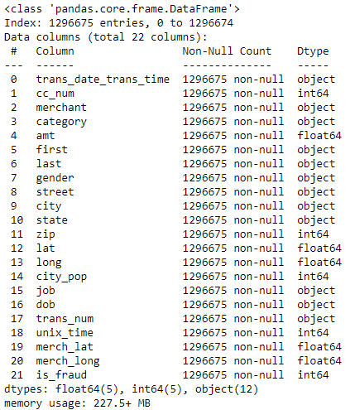
Data overview
2 datasets from Kaggle (train and test), not real data
The data contains CC transactions of 2 years 2020-2022
1.3M rows 23 columns in train and 0.5M in test
Each record represents a unique CC transaction
Luckily no null values
10 numerical and 13 categorical columns
The target variable contains 1 or 0 (‘is_fraud’)
The data is highly imbalanced (0.58% fraud in train)
In the end only 3 numerical columns were used (age, amount, city population)
3 columns with high cardinality (merchant -693 values, job – 494 values, city – 702 values)

Slide 7
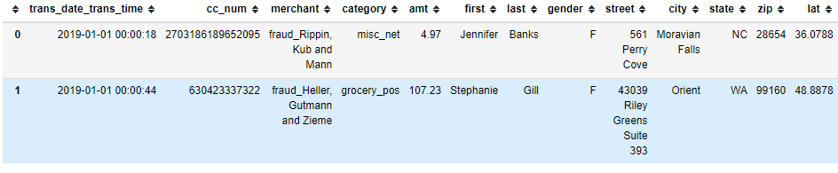
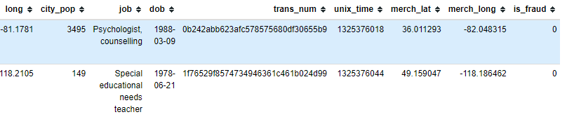
The data

Slide 8
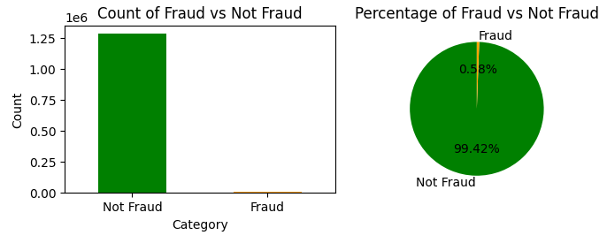
EDA
Target variable – is_fraud
The number of fraudulent cases is 7506 out of 1.289.169
The fraudulent cases compile 0.58% of total data.

Slide 9
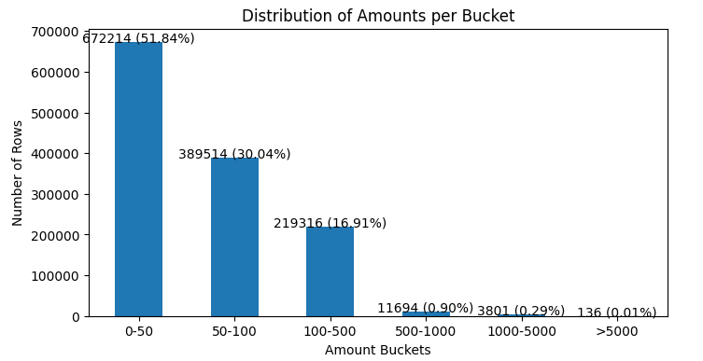
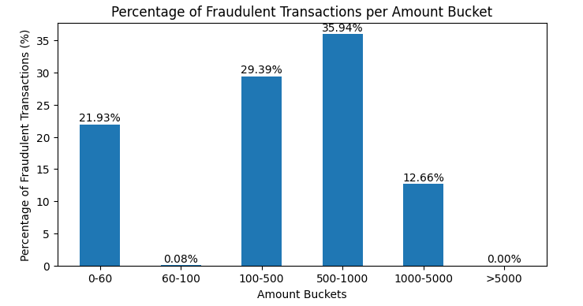
EDA
Number of transactions per bucket
It can be seen that most of the transactions lay in small amounts
Number of fraud per bucket
There is 21.93% of fraud in small amounts
100-500 take up almost 30%
Most fraudulent bucket is 500-1000 with 35.94%

Slide 10
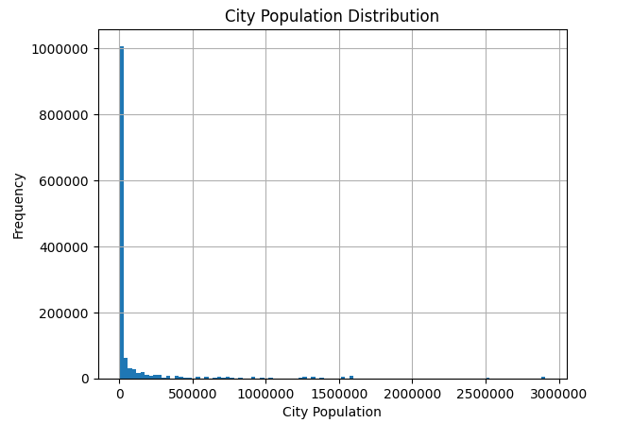
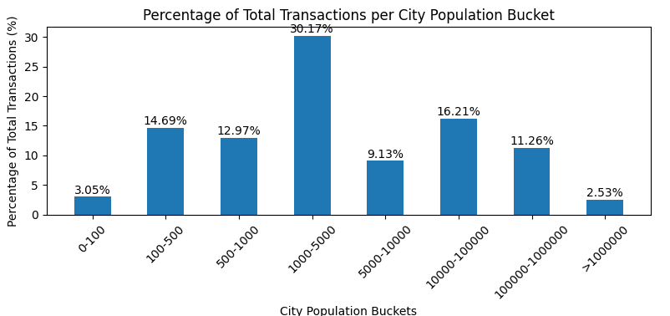
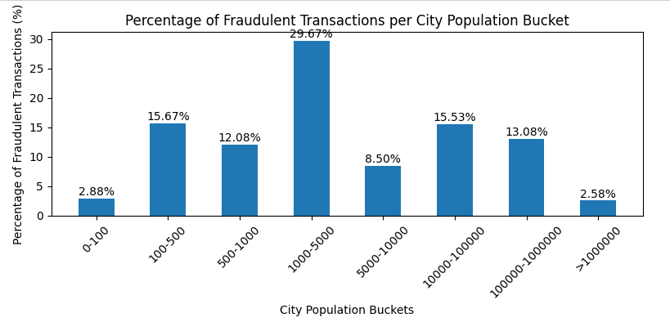
EDA
City population
Most of the transactions were conducted by users from small cities
City population
The distribution of total tnxns per city pop bucket looks similar to the distribution of fraudulent tnxns

Slide 11

EDA
Gender
The distribution of fraud vs not fraud for Gender looks quite similar

Slide 12
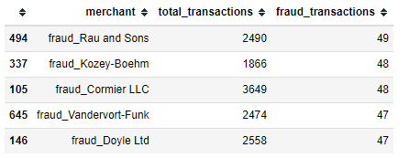
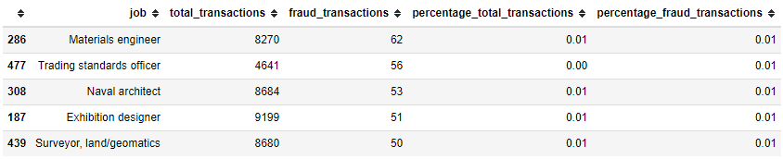
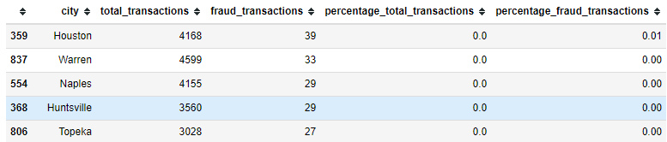
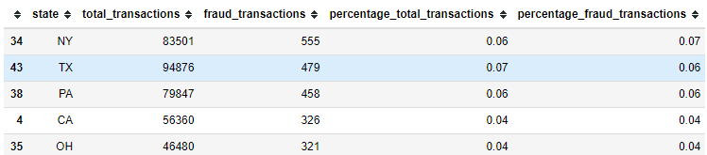
EDA, high cardinality columns
By intuition, merchant, city, job are features which will have less power of prediction

Slide 13
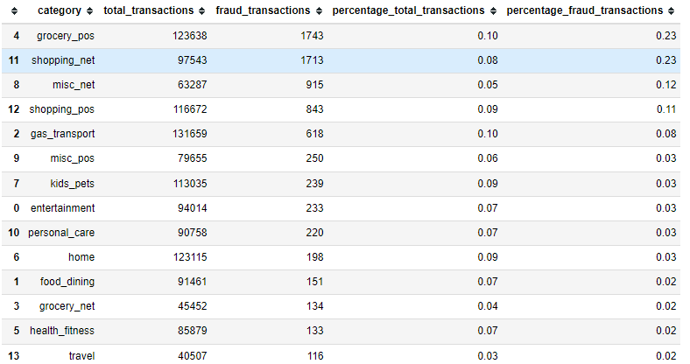
EDA
category
Top 3 categories take up 58% of fraud and only 23% by count of total tnxns

Slide 14
EDA
category
Top 3 categories take up 58% of fraud and only 23% by count of total tnxns

Slide 15
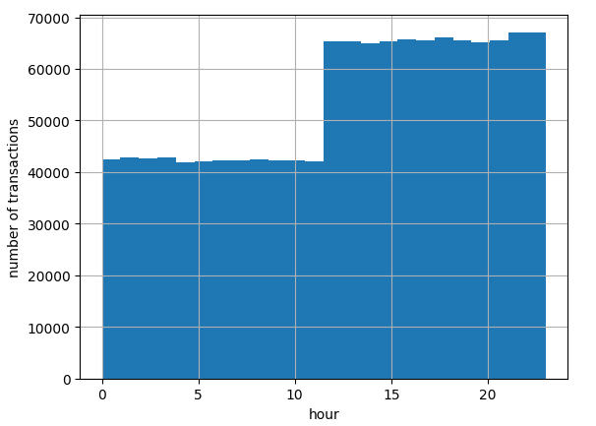
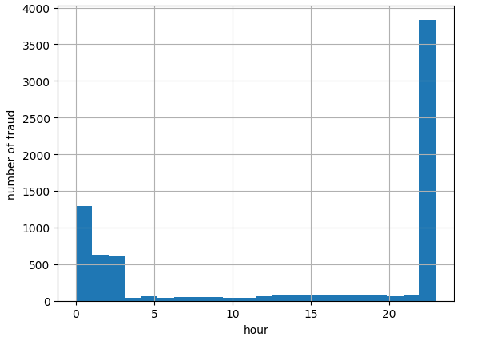
EDA
hour
Starting from the afternoon up to the noon there are more txnxns
22 and 23 hours are most fraudulent, 00-3 hours have high fraud as well

Slide 16
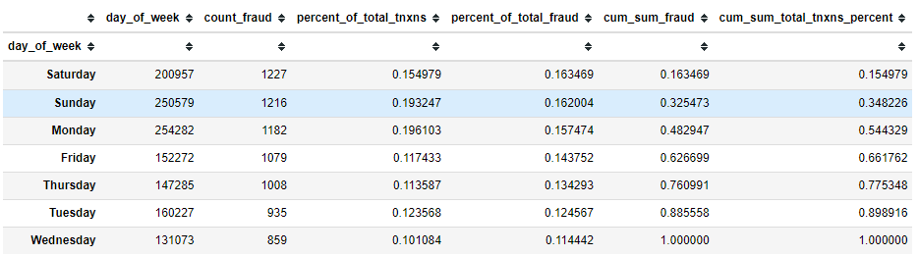
EDA
Day_of_week
Sunday and Saturday tend to be more fraudulent than other days
Day of month, month, year were not indicative

Slide 17
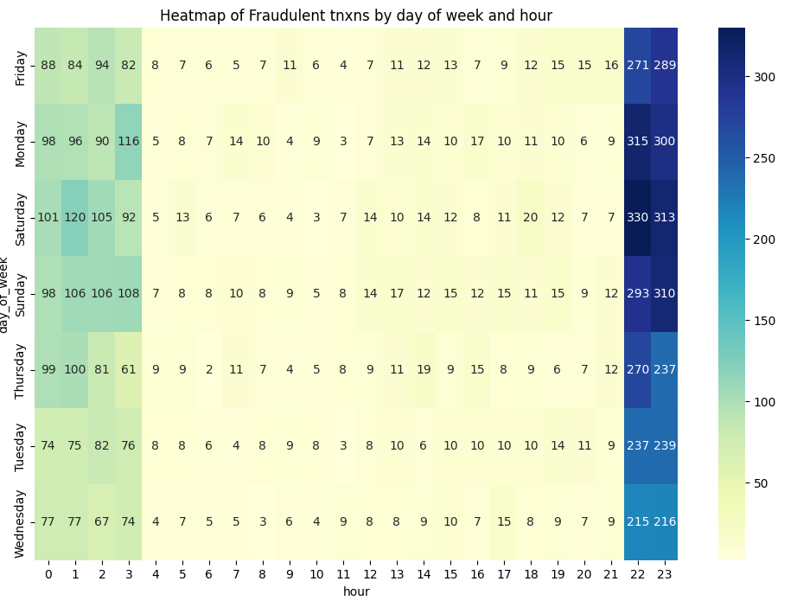
EDA
Heatmap day_of_week vs hour
We see the same fraudulent hours
All days of week are relatively fraudulent

Slide 18
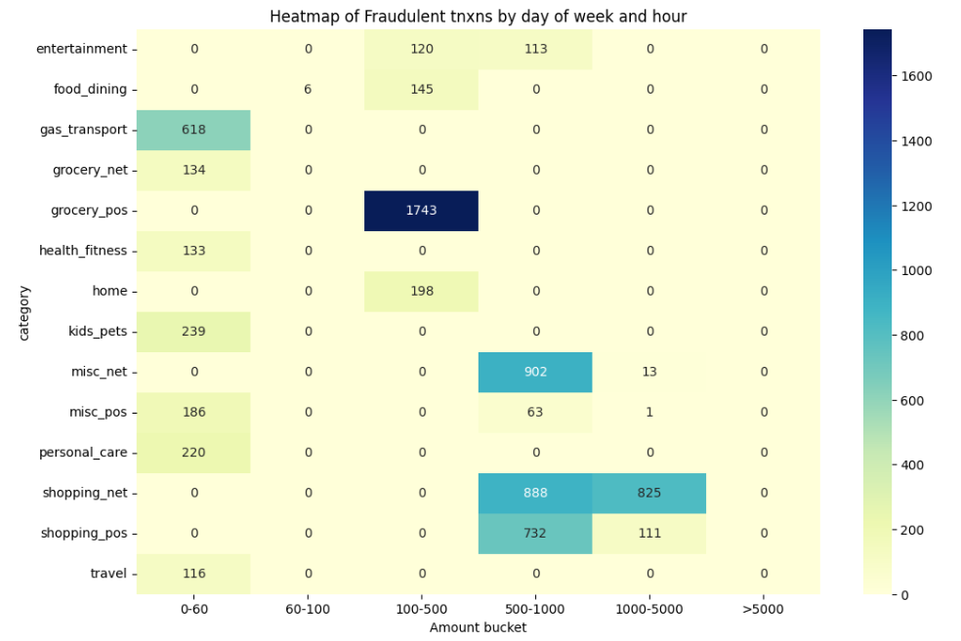
EDA
Heatmap Category vs Amount bucket
0-60 bucket is really fraudulent
Grocery_pos has a lot of fraud in 100-500 bucket
Shopping_net and shopping_pos are highly fraudulent in 500-1000 bucket
There is no fraud in the bucket over 5000

Slide 19
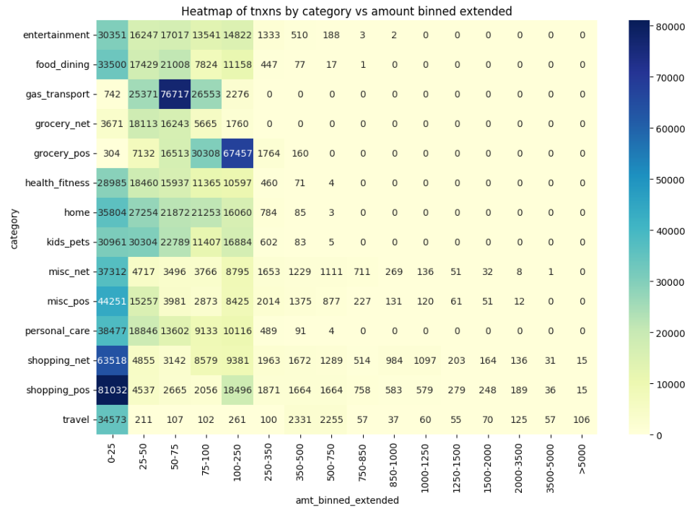
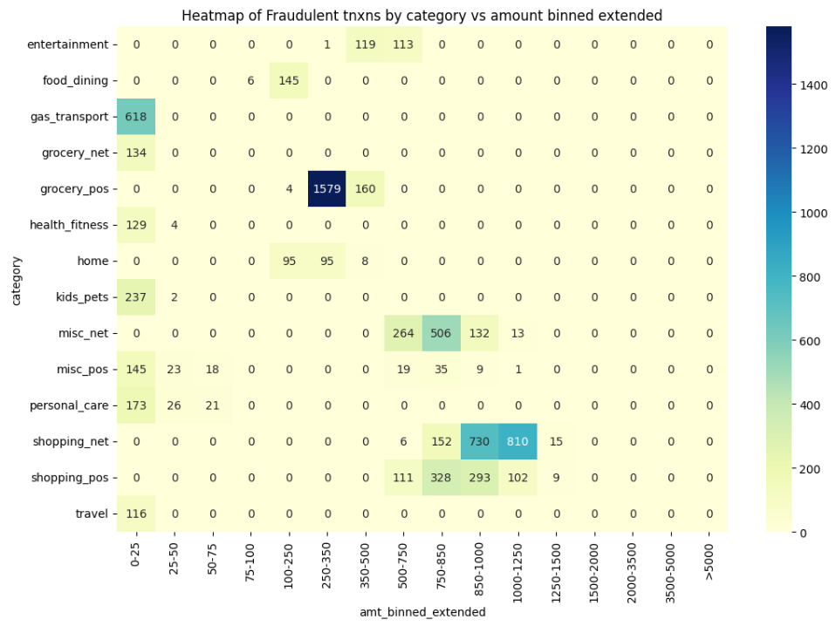
EDA
Heatmap Category vs Amount bucket extended
How different it looks now

Slide 20
Preprocessing and Feature Engineering (for benchmark runs)
Preprocessing :
Columns removed: 'trans_date_trans_time', 'cc_num', 'first', 'last', 'street', 'zip', 'dob', 'trans_num', 'unix_time','lat', 'long', 'merch_lat', 'merch_long’
All categorical columns were encoded with OneHotEncoder
Downsampling with various options were examined
Feature Engineering :
The following columns were created: age, day_of_week, hour, month

Slide 21
Strategies and models used
Models chosen:
XGBoost
CatBoost
LightGBM
Voting (apart from Decision Trees)
Strategies:
Due to the big size of data:
It was decided to use 1 hot encoding for all of the categorical variables (it turned into 2151 columns)
Due to the size of data downsampling and hyper parameter tuning was checked separately and manually
It was decided to use recall and precision as metrics and it was important to catch as much fraud as possible and to have mistakes as little as possible
Encoded data was saved as parquet (train and test to reduce the time for rerunning models)

Slide 22
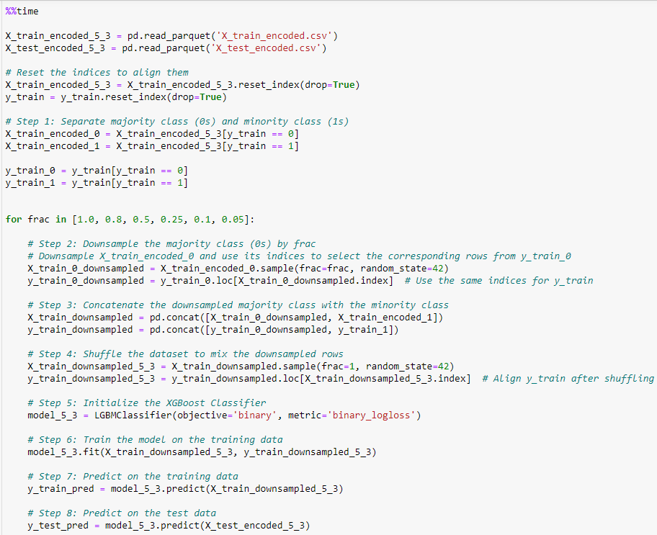
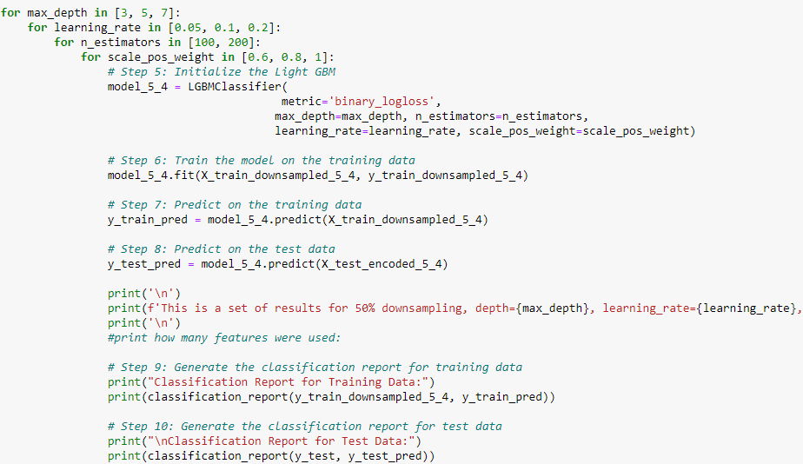
Example for tuning
A loop with downsampling
Loops with lists of hyper parameters

Slide 23
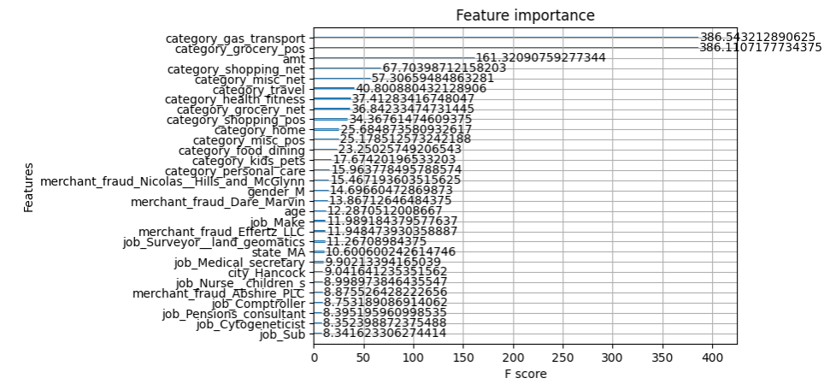
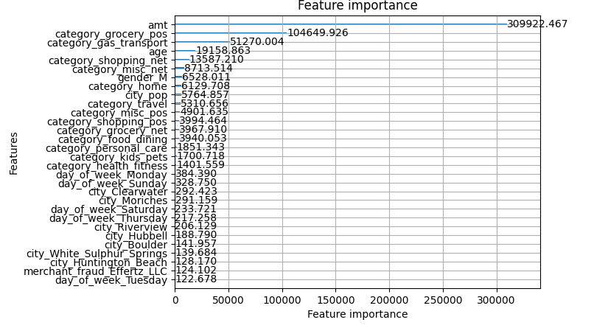
Example for feature importance
XGBoost
LightGBM

Slide 24
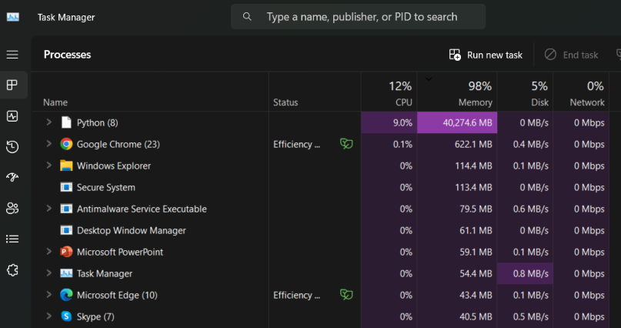
Issues
Lack of memory. Every new run – restart of Kernel
Errors while working with the names of column in LightGBM (it was needed to remove ‘json special symbols’

Slide 25
Base results (test)
Model | Base precision | Base recall
XGBoost | 0.77 | 0.52
LightGBM | 0.60 | 0.57
CatBoost | 0.73 | 0.46
Final results (test)
Model | Base precision | Base recall
XGBoost | 0.68 | 0.68
LightGBM | 0.71 | 0.66
CatBoost | 0.76 | 0.61
Voter | 0.71 | 0.66

Slide 26
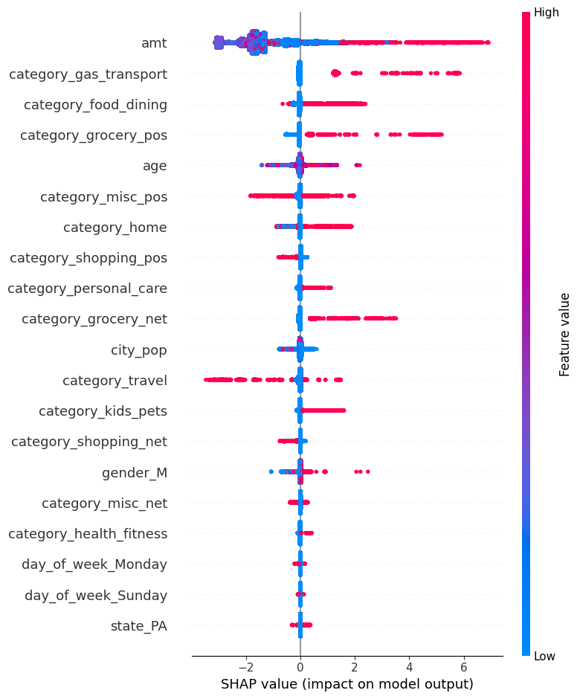
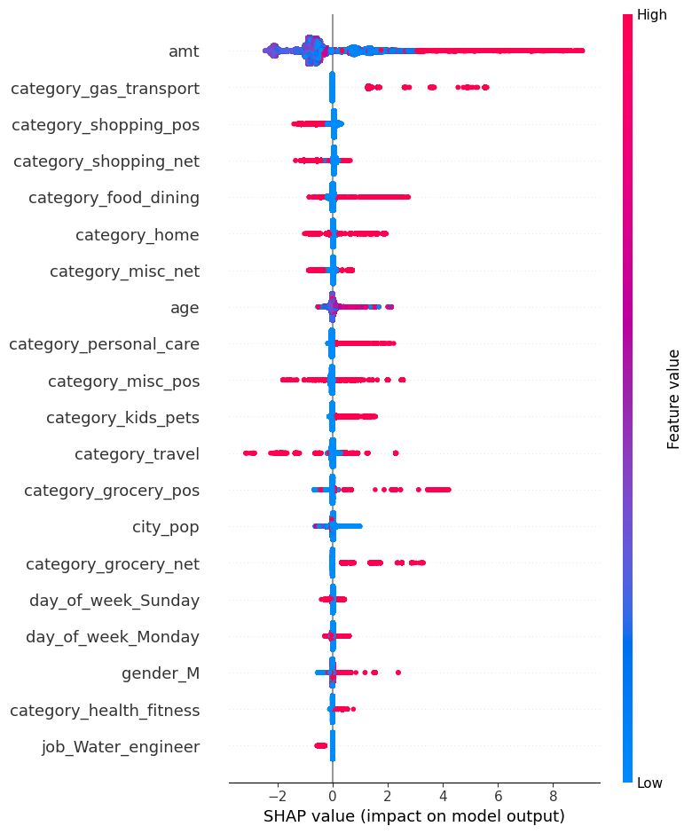
Examining shap summary plot
XGBoost
LightGBM

Slide 27
Conclusions
General conclusions:
Overall the results are quite satisfying
50% downsampling gave optimal results
Searching for better parameters helped improving the precision and recall a little
Models:
XGBoost, CatBoost and LightGBM show quite similar results
It was noted that LightGBM worked significantly faster than its competitors
LightGBM is the winner according to the balanced results

Slide 28
Thank you for your attention!

